Slide 1
Reach Fast Gas Calculator App

Slide 2
Problem:
“I want to know how much gas it costs to travel from destination to destination.”
Target Audience:
-Everyday drivers and Delivery Workers

Slide 3
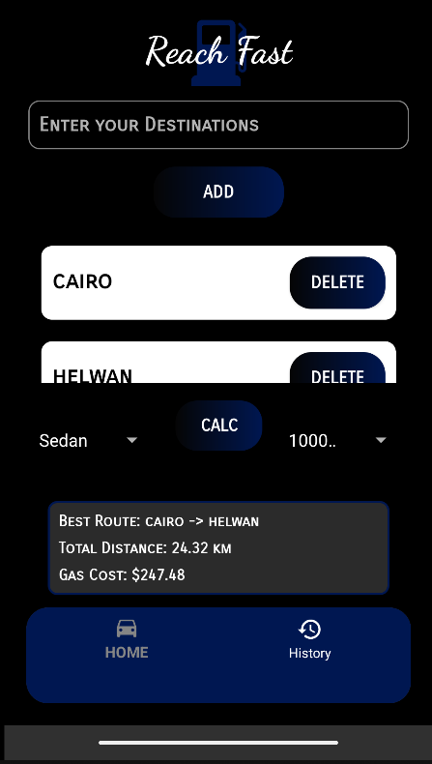
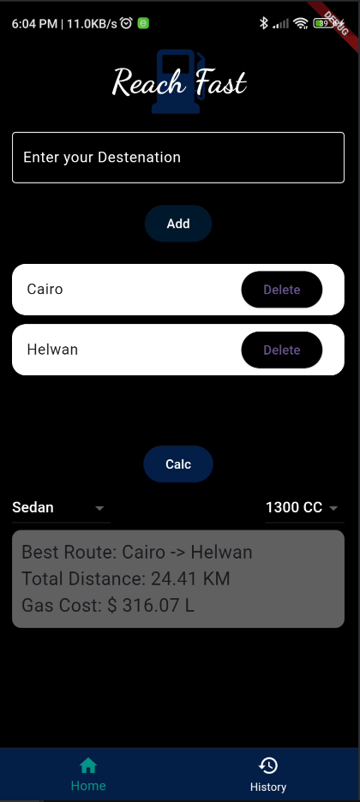
Our Solution: The Reach Fast App
The Reach Fast app is designed to help users find the route between multiple destinations and calculate the total gas cost for the trip.
-It provides users with a way to input locations and determines the cost of fuel required based on the total distance, car type and CC. -Android Native and Flutter.

Slide 4
Features (Flutter):
Tools and Libraries Used:
Gas Cost Estimation: Calculates the gas cost for the trip based on the distance, manually put fuel price, and standard fuel efficiency rate.
Location Tracking: Integrates GeoLocator to detect the user's current location.
Area History: Allows users to input and save areas, and the app maintains a history of previous calculations.
Persistent Storage: Stores user inputs, results, and history using Hive, ensuring that the data is saved between app sessions.
GeoLocator: To get the user’s current location.
Geocoding: For converting place names into latitude and longitude.
Hive: For storing data persistently.
Quick Alert: To display animated alert dialogs such as success, error, warning, confirm, loading or even a custom dialog.

Slide 5
Features (Native):
Tools and Libraries Used:
Gas Cost Estimation: Calculates the gas cost for the trip based on the distance and a standard fuel efficiency rate.
Location Tracking: Integrates AirLocation to detect the user's current location.
Area History: Allows users to input and save areas, and the app maintains a history of previous calculations, which is reset every 48 hours.
Persistent Storage: Stores user inputs, results, and history using SharedPreferences, ensuring that the data is saved between app sessions
AirLocation: To get the user’s current location.
Geocoder API: For converting place names into latitude and longitude.
RecyclerView: For displaying the list of areas and route history.
SharedPreferences: For storing data persistently.
Gson: For converting Java objects to JSON and vice versa.
Toast Messages: For user feedback when actions like adding a new area are performed.

Slide 6
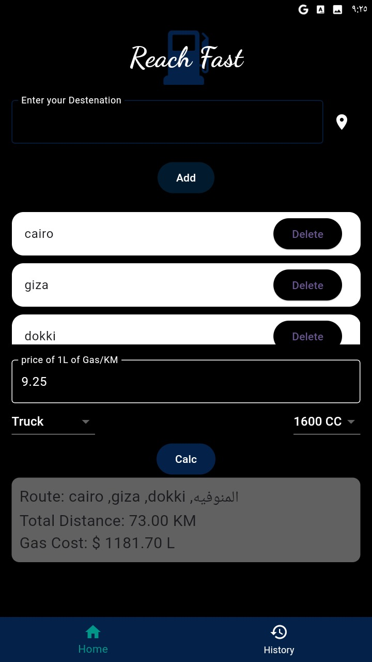
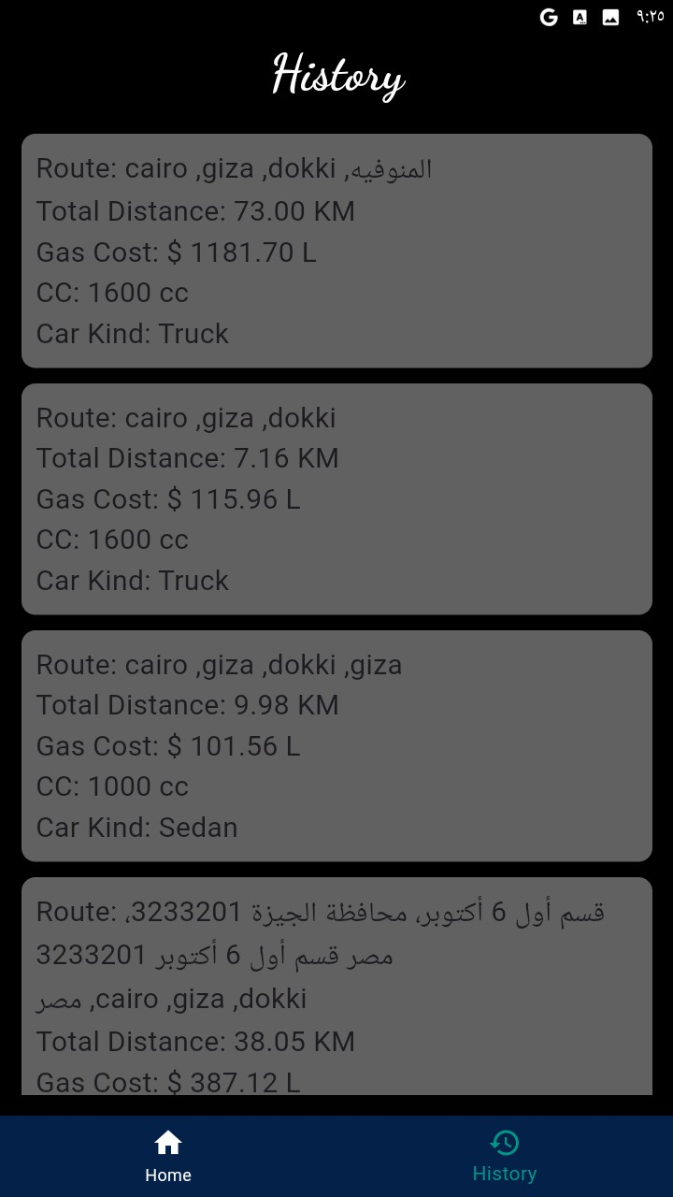
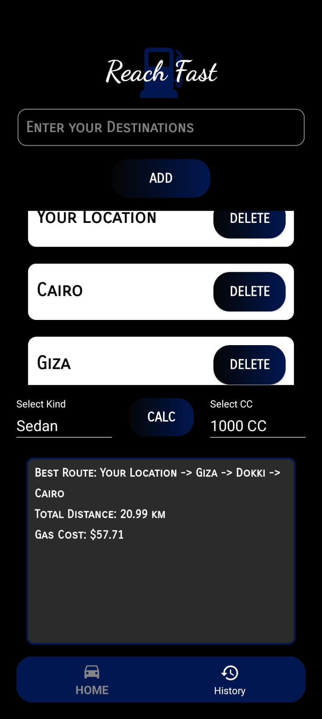
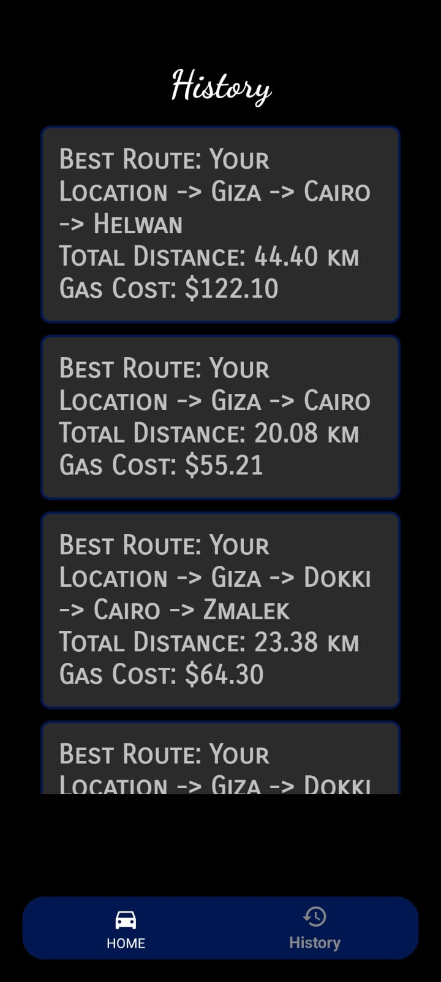
Screenshots
Flutter
Native

Slide 7
Thank you
Abdelrahman Ahmed
Mohanad Osama Mohamed
Deyaa El-Din Ahmed Saber
Alhassan Tameem Elwy Ali Amer
Ahmed Mohamed Elkholy
Khaled Ahmed Soliman
Mohamed Yasser

